Slide 1
TimeLapseReg an ImageJ plugin for drift correction of video sequence in time-lapse microscopy
Raghavender Sahdev, Tomasz, Dimiter Prodanov, Daniel Sage

Slide 2
Motivation
Drift in microscopy
Time-lapse microscopy experiments
Calcium imaging: 3 minutes at 100 Hz > 18000 frames
Bacterial colony study: 3 days every 15 sec. > 17280 frames
Small and slow displacement
Slippage of the focus mechanism
Thermal gradients in the microscope
Needs
Automatic software (long sequence, multiple channel)
working with diffuse structure
working with noisy data (e.g. 2P microscope)

Slide 3
TurboReg/StackReg
TurboReg/StackeReg: Java plugins of ImageJ
TurboReg: manual or automatic alignment of 2 images
contains the engine (computational part of the registration)
StackReg: automatic recursive alignment of 2 consecutive frames
useTurboReg
TurboReg/StackReg
Very robust in presence of noise (multiresolution)
Reasonably fast
No need of keypoints of visual structure (mutual information criteria)
Geometric transformation expressed by 2 sets of points
TurboReg/StackeReg: defacto standard in calcium imaging
Akerboom (2012) Silbering (2012) Yang (2012) Lecoq (2014) Tiang (2009) Kaifosh (2014) Mukamel (2009) ...

Slide 4
Pratical limitations of StackReg?
No choice for the reference image
Require that the complete sequence fit in RAM -> impossible to process long sequence
Do not allow to compute the transformation on one channel and to apply it on other channels
Do not prevent large transformation (we know that we have small drift)
No preprocessing to denoise the noisy image

Slide 5
Goal of TimeLapseReg
Goal: drift correction of long sequence of time lapse microscopy images (small translations/rotations).
Improve User interface
Uses the TurboReg/StackReg
Application: Calcium fluorescence imaging to reconstruct neuronal and glial cells populations activity.

Slide 6
TimeLapseReg
Registration Process
Select method for Reference Image
Discard inappropriate frames
Set translation and rotation limits
Trajectory drawn on reference image
Chart showing transformation
Table being dynamically populated while computing transformations
Transformations stored in csv file
Output
input
Input TimeLapse sequence
Reference Image is computed as in Fig. 3
 | Good Transformation
 | Invalid transformations
 | Current image under consideration
 | Reference Image
 | Discarded Frame
 | Frames yet to be computed
Direction of computation from frame 1 to n
Computing transformations and populating the Feedback Table 1 on the go
. . . . .
 |  |  |  |  |  |  |  |  |  | X | X
Frames 1,2,3,4……n
Frames discarded based on pre-processing step

Slide 7
Alignment Process
Alignment Process
Choose
Project Path
Transformation file
Aligned images folder
Read Computed Transformations from csv file
Aligned images stored in the specified Folder
input
output
 | Good Transformation
 | Current image under consideration
 | Discarded Transformation
 | Frames yet to be computed
Direction of alignment from frame 1 to n
 |  |  |  |  |  |  |  |  |  | X | X
Frames 1,2,3,4……n
Frames discarded during registration

Slide 8
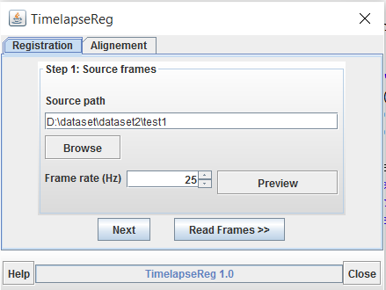
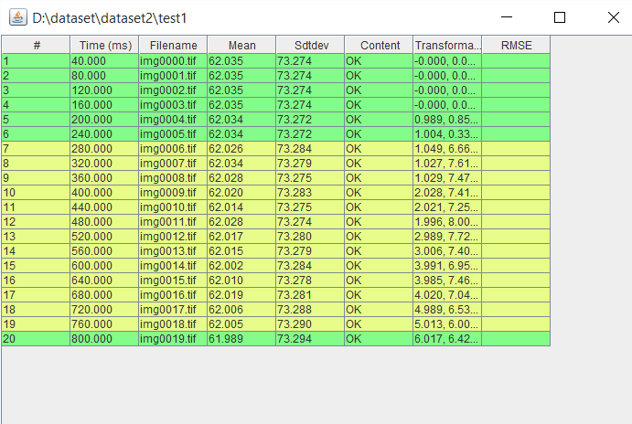
Features of TimeLapseReg
User gets an option to input the timelapse sequence and set the frame rate
User gets dynamic feedback in the form of a table listing the initial few frames and their info

Slide 9
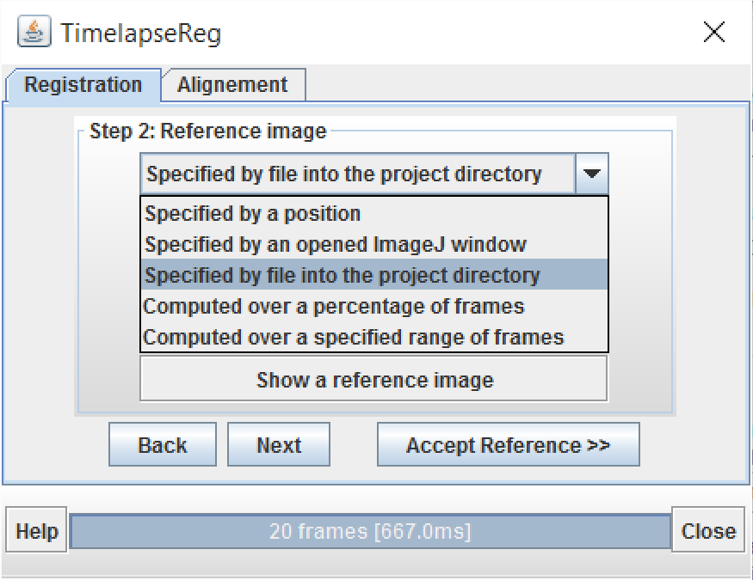
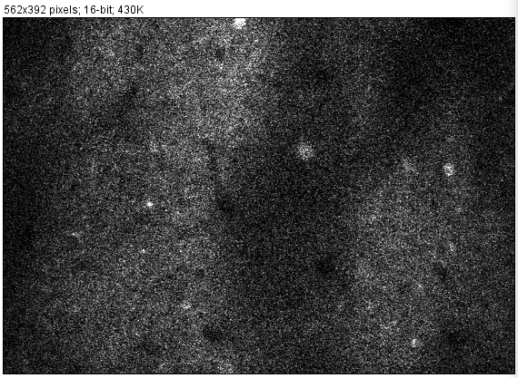
Step 2: Reference image computation
User gets the option to compute the reference image by a number of metrics
Average
Maximum
Median.
The reference image is computed and user can view it ; user may choose a different metric if he does not like the computed reference image

Slide 10
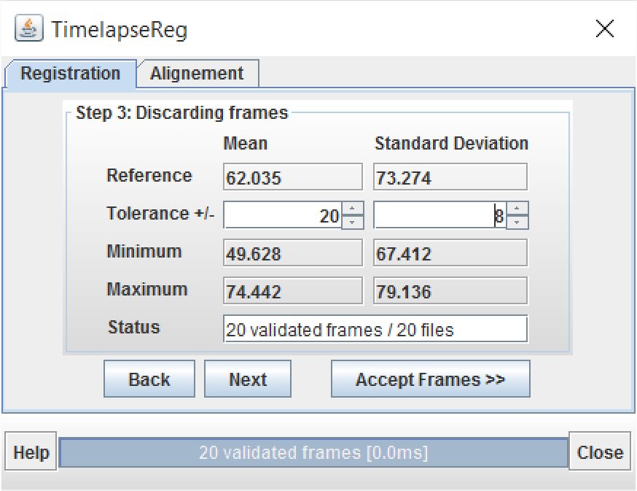
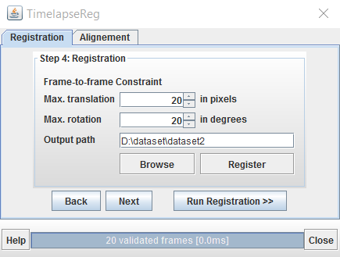
Step 3,4: Discarding frames, Registration
User gets the option to discard inappropriate frames which may make result in unstable transformation
User get the option to set the limits under which the translation is to be treated as valid.

Slide 11
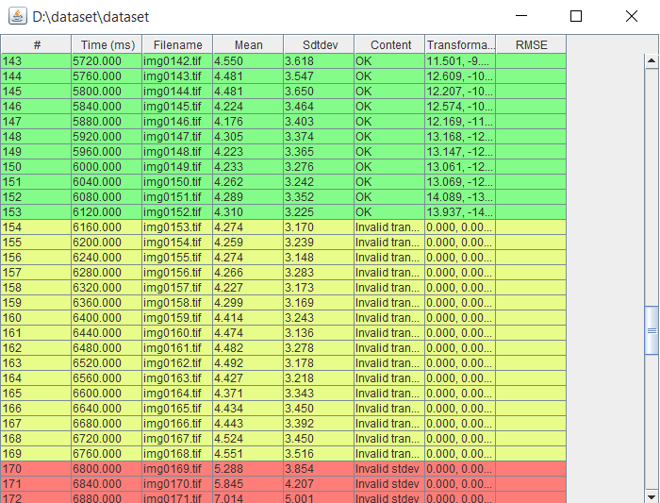
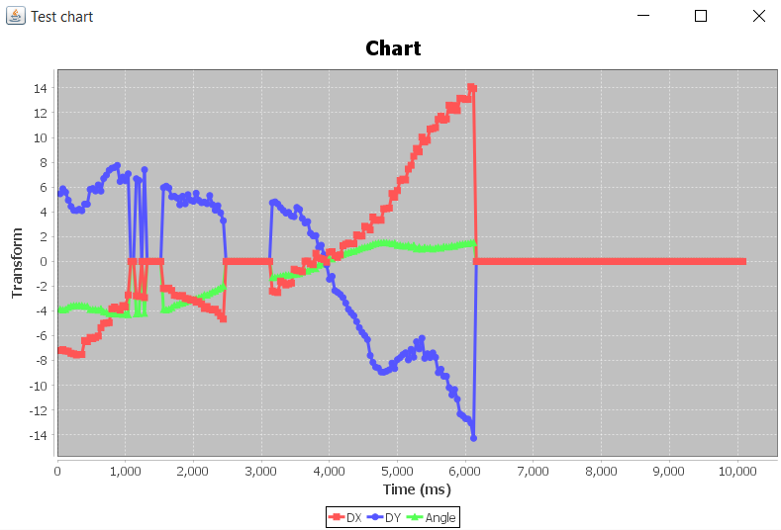
User-Feedback
A dynamically generated table is produced listing the frame info computed transformations
Green – valid transformation
Yellow – Invalid transformation
Red – Invalid standard deviation / mean
At the termination of the registration process user can see the computed transformations through the chart above
Red curve – translation in x
Blue curve – translation in y
Green curve – rotation angle

Slide 12
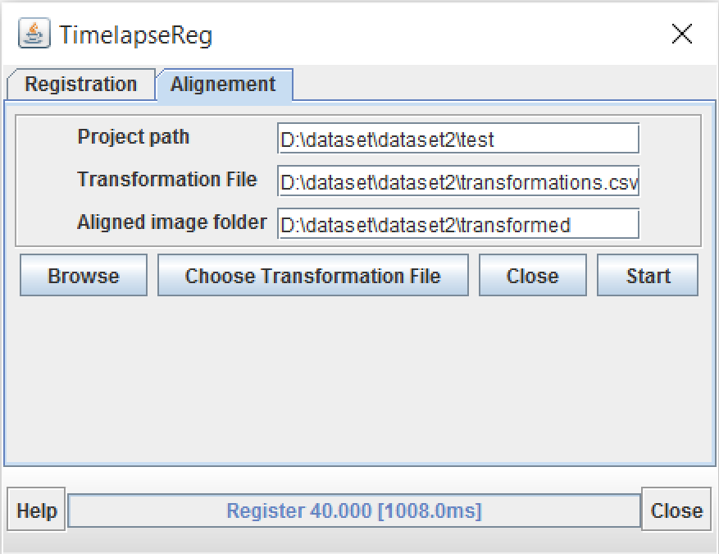
Alignment Process
After registering the images, user get to choose the channel to which he wants to apply the transformation, for aligning the images

Slide 13
Acknowledgements
Malin Sandstrom, International Neuroscience Coordinating Facility, Sweden
Tomasz, University of Heidelberg, Germany
Dimiter Prodanov, INCF Belgian Node, Belgium and EHS/NERF, Imec, Leuven, Belgium
Daniel Sage, Biomedical Imaging Group, EPFL Switzerland

Slide 14
Thank You! any questions ?

